Slide 1
Project CryptOL™
Alexander Gribtsov Department of Computer Science and Software Engineering Monmouth University 400 Cedar Ave, West Long Branch, NJ 07764, United States of America | Chris Woszczak Department of Computer Science and Software Engineering Monmouth University 400 Cedar Ave, West Long Branch, NJ 07764, United States of America | John Guseman Department of Computer Science and Software Engineering Monmouth University 400 Cedar Ave, West Long Branch, NJ 07764, United States of America
CS-492A

Slide 2
Background:
Implementation of different types of artificial intelligence algorithms can produce fit data that predicts the price of different cryptocurrency types such as BitCoin.

Slide 3


Related Work:
Two related projects were observed for cross comparison of data performance and overall cryptocurrency price forecasting experience.

Slide 4
Nirav from Pirimid Fintech and his open-source LSTM Neural Net model.
After doing research on this project the superiority of this model became very clear. The team will be integrating this open-source model as part of a multi algorithm package.

Slide 5
Crypto Forecast, the AI predictions Android app.
This product is a fully finished product that uses a neural net model for predictions. The limitation is in it using a single algorithm and therefore this competitor’s best feature is the interface.

Slide 6
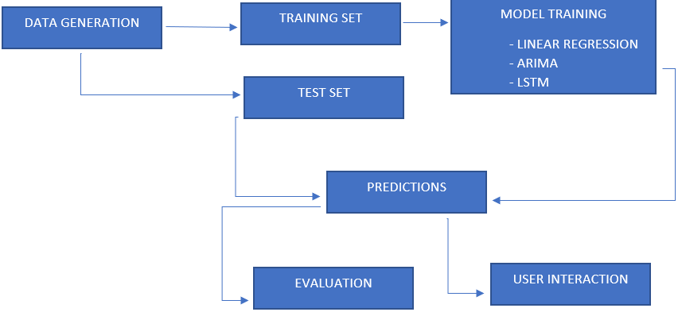
General Project Design
Data generation
Splitting the data
Model training
User interaction

Slide 7
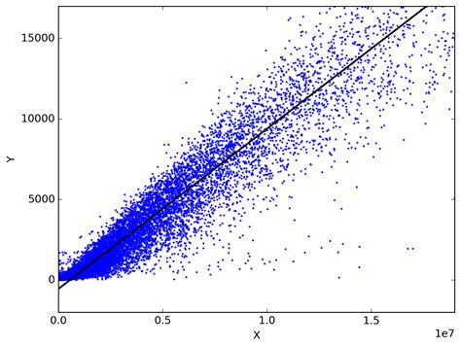
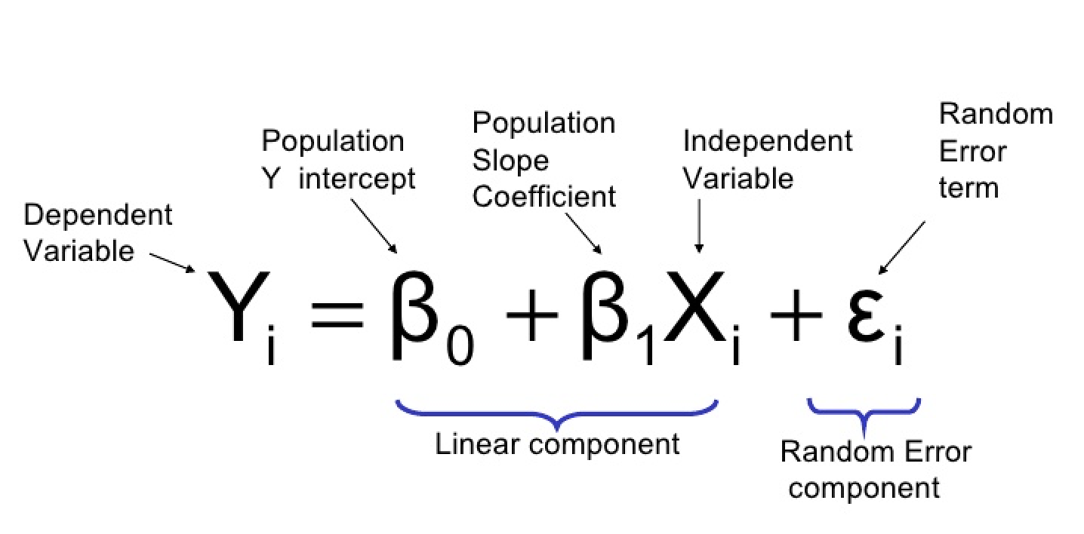
Linear Regression
Simple Linear Regression vs Multiple Linear Regression

Slide 8
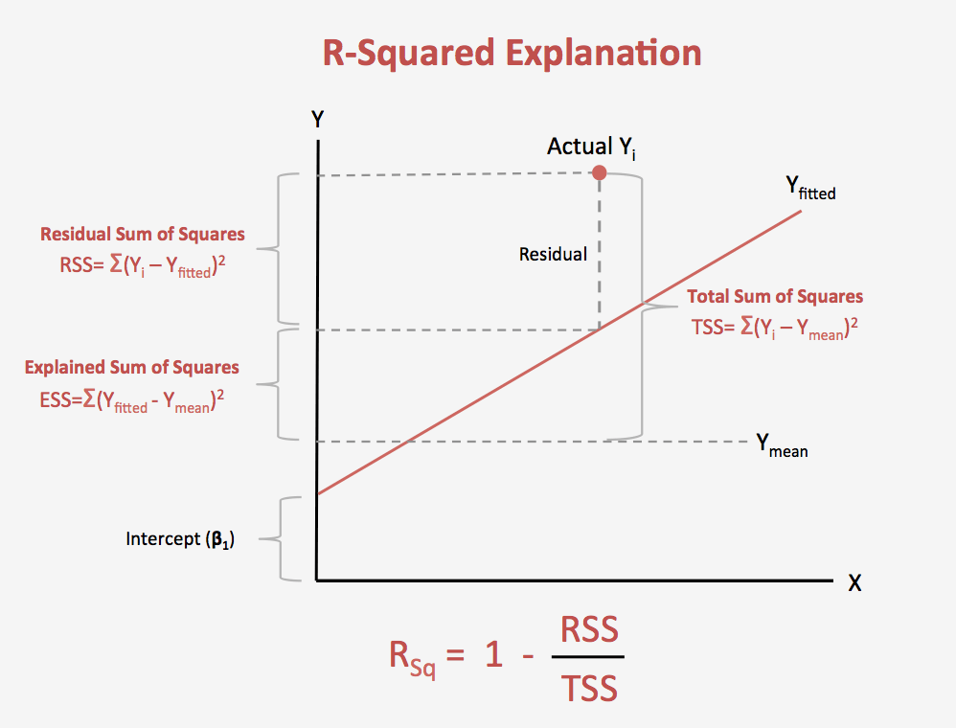
Linear Regression Assessment - R-Square
One example of linear regression model assessment

Slide 9
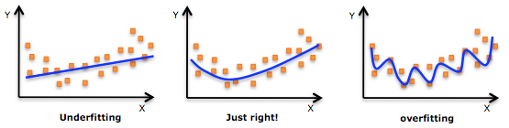
Linear Regression Problems
Overfitting
The model does not perform well against new data.

Slide 10
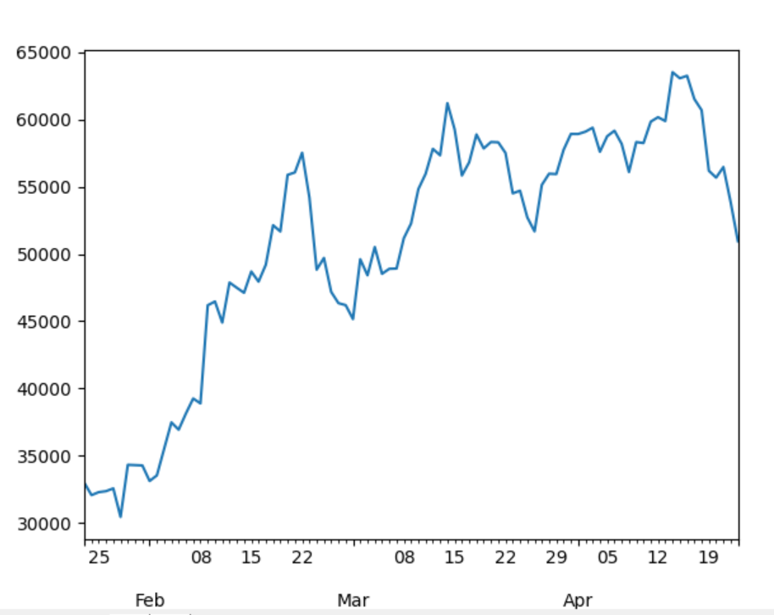
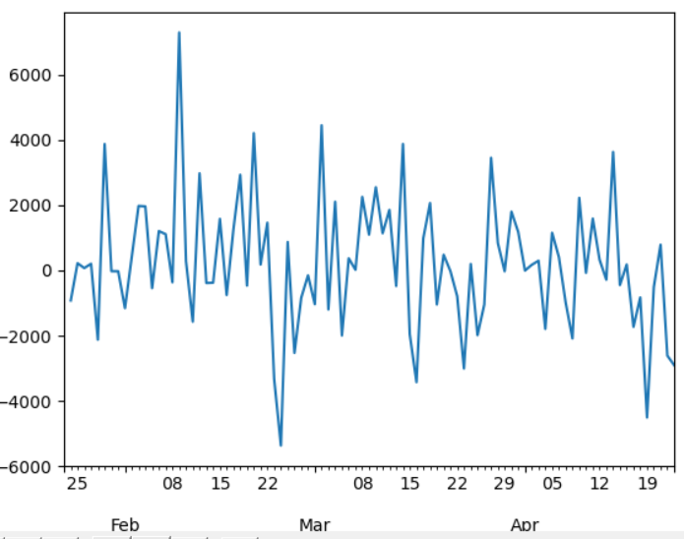
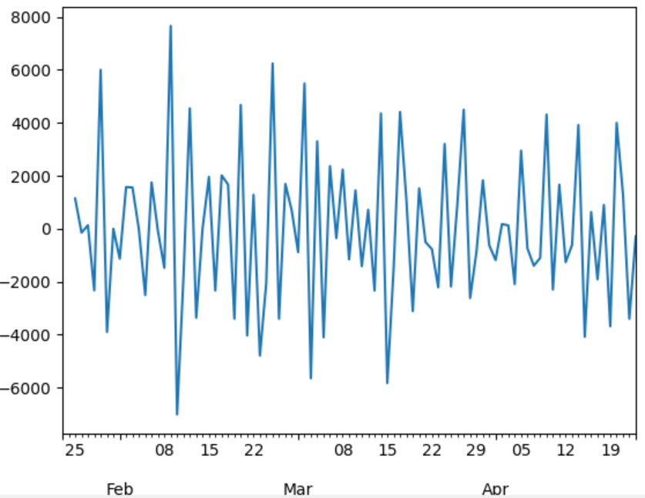
Autoregressive Integrated Moving Average
Time series forecasting
Multiple linear regression used a combination of outside predictors.
ARIMA predicts future values based only on previous values.

Slide 11
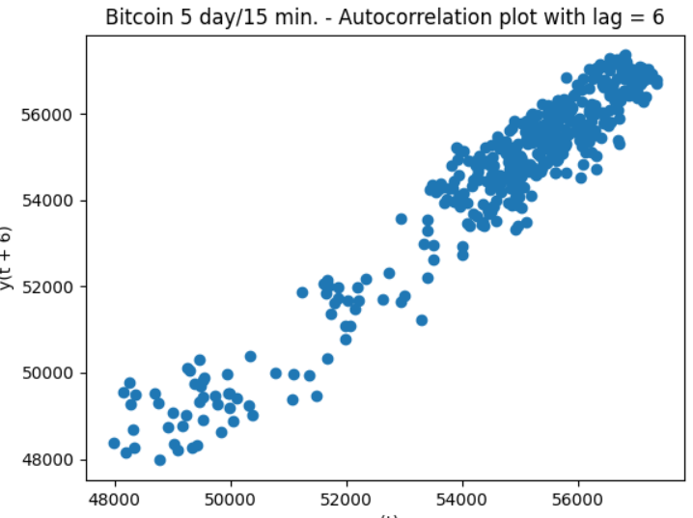
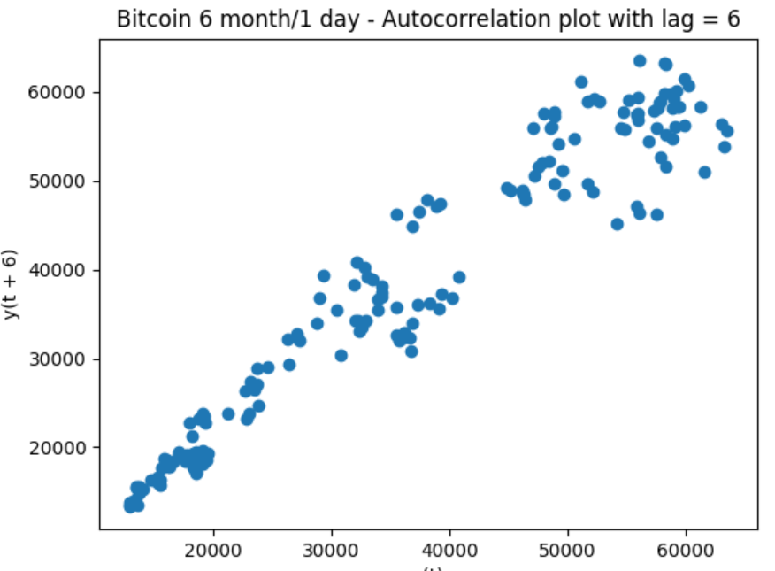
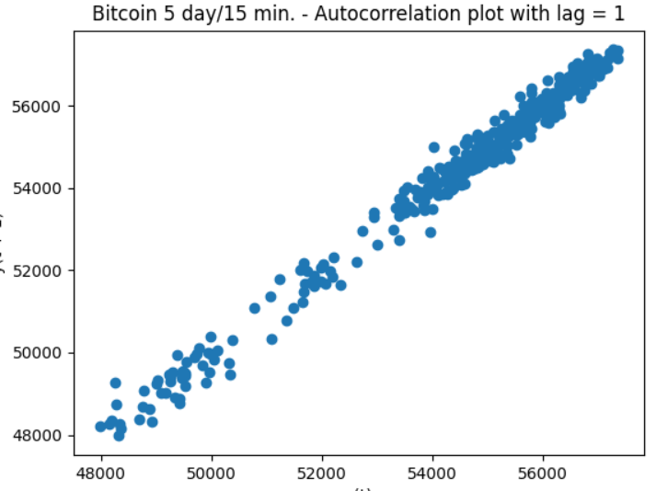
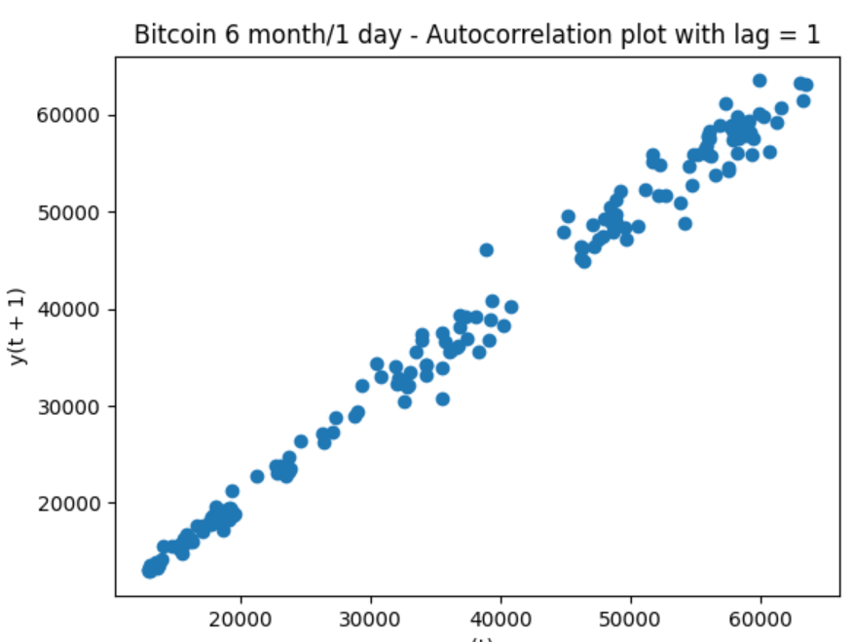
Looking at Lag Periods

Slide 12
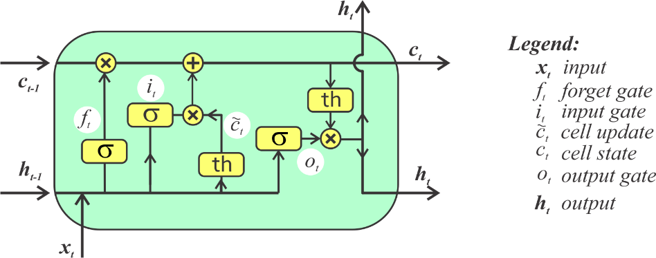
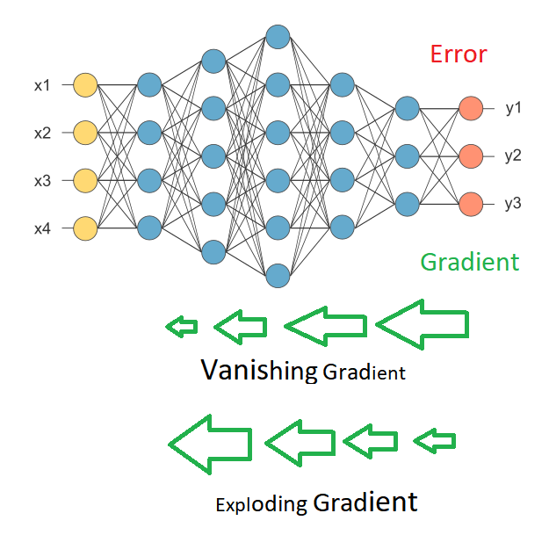
a
Uti
liz
Long Short-Term Memory
But why LSTM?
LSTM utilizes a cell state, it is composed of 3 main gates
-input
-output
-forget
This cell state provides the ability for the gradient (Tanh activation function in our case) to travel backwards through time freely. Acting as a memory, this cell state significantly helps reduce gradient descent issues that are common in other RNNs

Slide 13
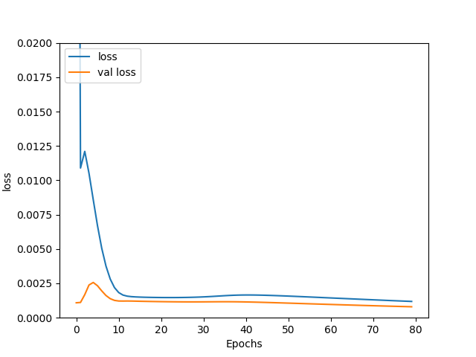
Uti
l
a
Long Short-Term Memory
Optimization through Experimentation
In order to create a well optimized and accurate model. One must minimize training loss & validation loss, while keeping the values of both as similar as possible. This prevents over and under fitting, in our case this means in general more accurate market indication.
Our LSTM model
-Sequential stacked
-Multivariate (Open, High, Close)
-15 minute intervals, 3 day periods
Many factors can affect these losses, however through testing when considering our 3 features, at the period and interval mentioned. The following hyperparameters proved to correspond to our accuracy the most. Number of neurons, number of epochs, and type of activation function.
After testing combinations of these hyperparameters over a week, 4 times a day. The combination that had the highest consistency of accuracy were achieved via: 256 neurons, 80 epochs, while using tanh activation function. During this week the model averaged 52% accuracy with a high of 68%!

Slide 14
Project Deployment
This project is deployed on a full stack python integration environment called Anvil Works for web applications.
A full demo will be presented at the end of this presentation.
Private testing link: https://G3WJ5SHZVWHWNTEW.anvil.app/DGM3NSTIXO3I47QAPSD4A6ZV
Public Testing Link:
https://www.itechnologyllc.com/cryptol
Deployable domain: https://www.projectcryptol.com

Slide 15
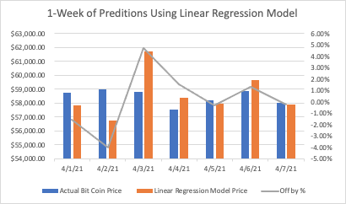
Experiment Testing
Embedded into the CryptOL™ application as part of the design project is a classical testing technique of fitness of running data. (Shown in the Demo)
In one random week in April the logistic recursion algorithm was within 5 accuracy in predicting throughout the week.

Slide 16
more about Project CryptOL™
Going into the project the team had little to no experience in the field of data sciences.
Well into the project all members of the team became familiar with most common data science terminology and functionality of standardized techniques.
Subjects from online machine learning to feature engineering and many algorithmic techniques such as logistic regression, time series, survival modeling, long short-term memory (LSTM) were explored.

Slide 17
Conclusion
Project CryptOL™ is a great example of how standardized data science techniques and algorithms can be applied together in an application with a GUI to present a user strong indicator of future cryptocurrency price.
This project concluded with a fully functional full stack web application that predicts cryptocurrency prices. The data testing conducted clearly shows the close fitness and accuracy of the data with a small error margin.

Slide 18
Demo
The link below demonstrates the full functionality of CryptOL™ at premium paid level.
Note: out of six algorithms that are in design, three are deployed and fully functional with risk assessment and data fitness indicator fields:
https://G3WJ5SHZVWHWNTEW.anvil.app/DGM3NSTIXO3I47QAPSD4A6ZV
https://anvil.works/build#

